Slide 1
Sunshine 2
Program 11
Pages 96-100

Slide 2
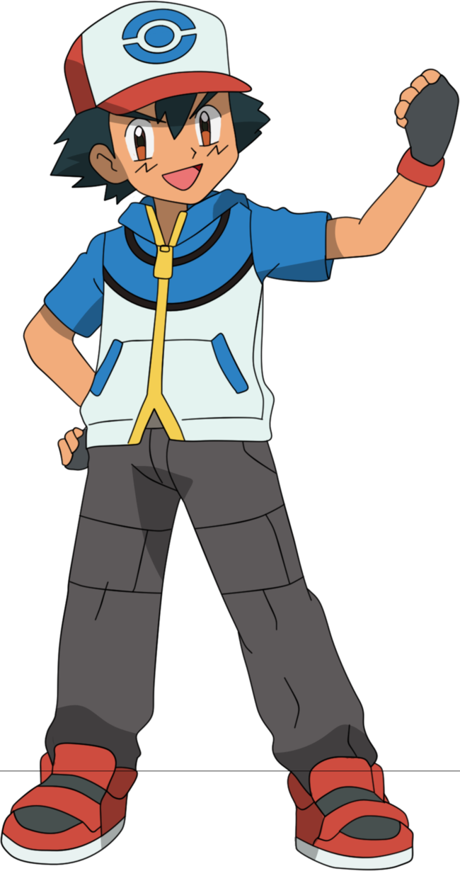

Satoshi
uses
.
Monsterballs
used
monsterballs
are
by
Satoshi
be動詞＋過去分詞
前置詞
by 人・キャラクター・国
in 国・場所・季節
for 食事・休日・季節
on 特定の日・休日
be動詞
am
is
are
was
were
例

Slide 3
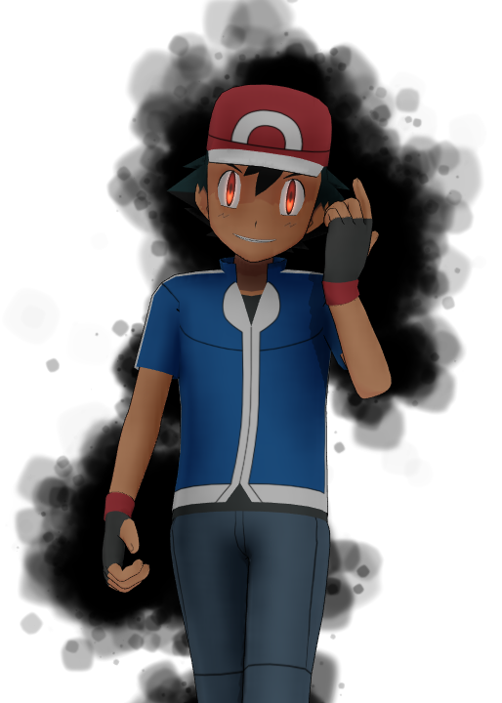

Satoshi
動詞：
catch
30 seconds
Pikachu
Hint
主語 | 動詞 | もの
Satoshi catches Pikachu.
1

Slide 4
Satoshi
動詞：
caught
catch
過去分詞：
30 seconds
Pikachu
Hint
もの | be動詞 | 過去分詞 | 前置詞 | 主語
2
Pikachu is caught by Satoshi.

Slide 5
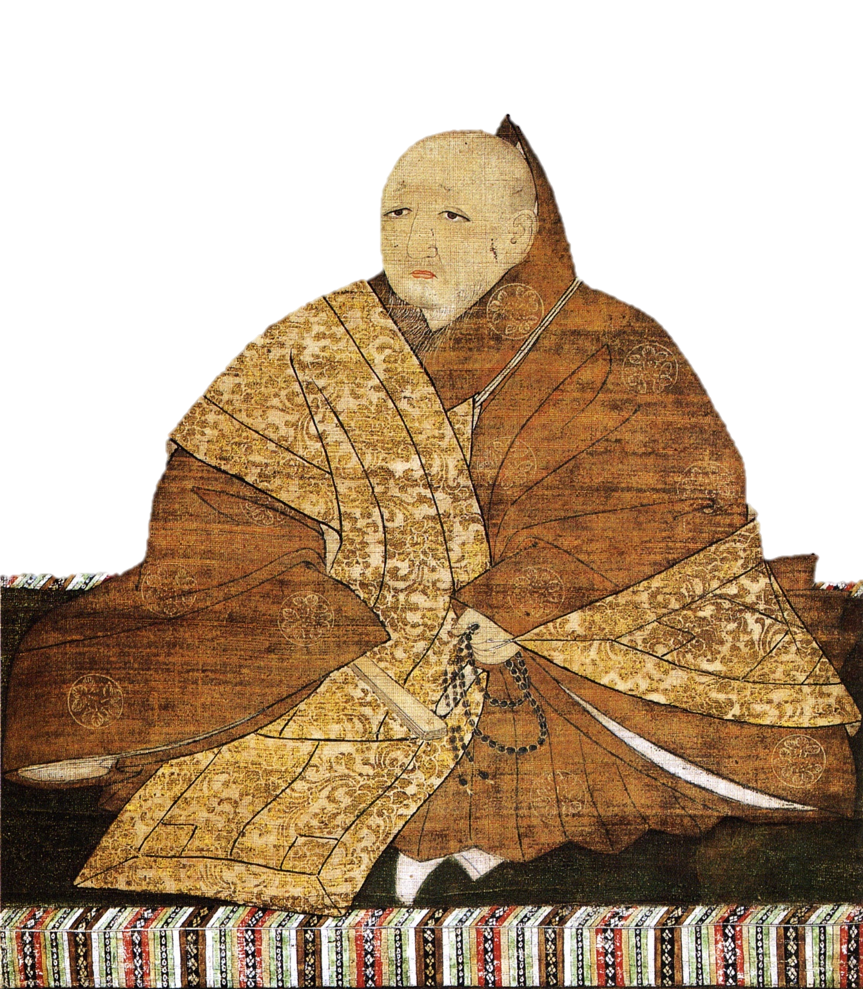
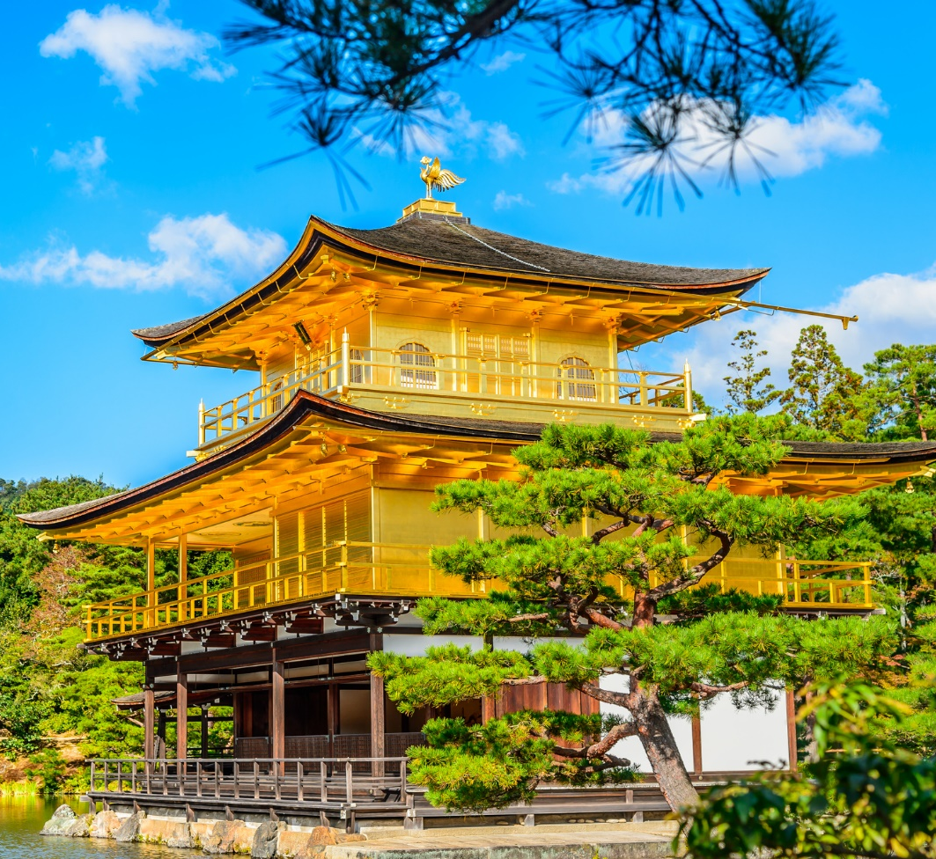
Yoshimitsu Ashikaga
動詞：
buildの過去形
30 seconds
Kinkakuji
Yoshimitsu Ashikaga built Kinkakuji.
3

Slide 6
Yoshimitsu Ashikaga
動詞：
buildの過去分詞
30 seconds
Kinkakuji
Kinkakuji was built by Yoshimitsu Ashikaga.
4

Slide 7
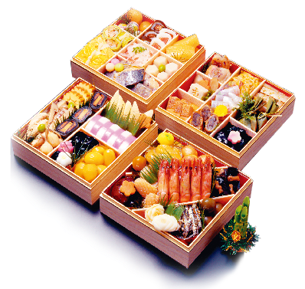
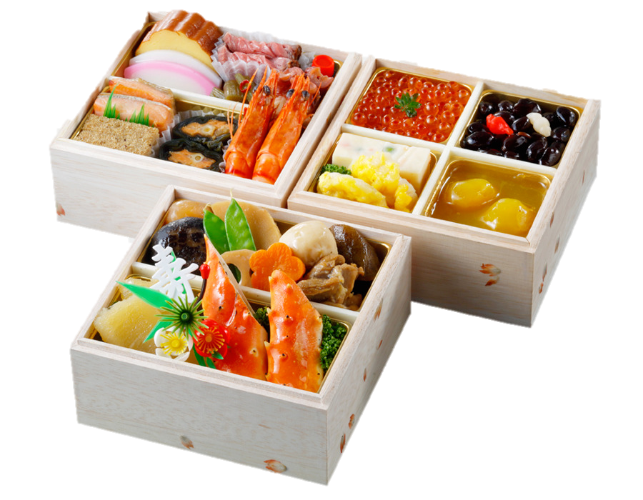
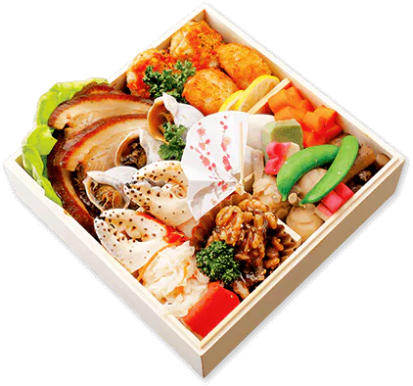
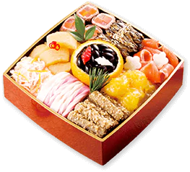
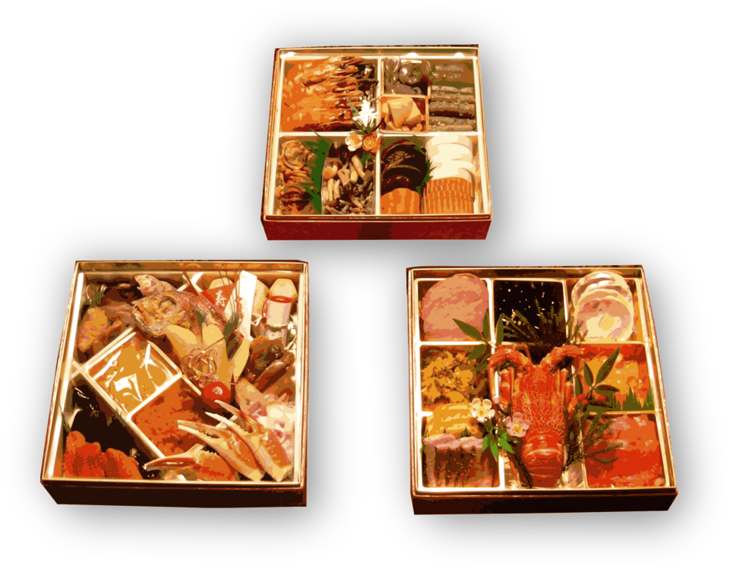
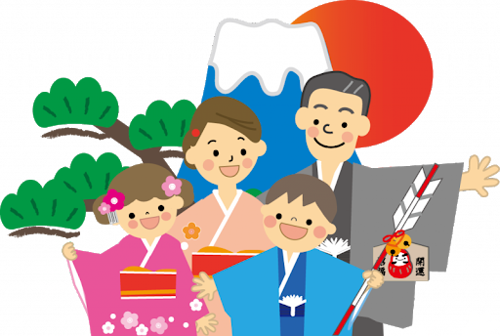
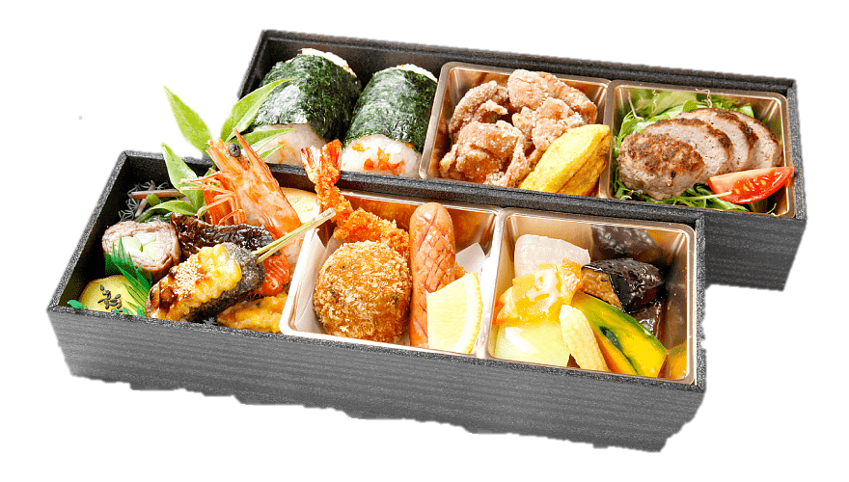
eatの過去分詞
動詞：
Osechi
30 seconds
New Years
Hint
もの | be動詞 | 過去分詞 | 前置詞 | 主語
 |  |  | on
Osechi is eaten on New Years.
5

Slide 8
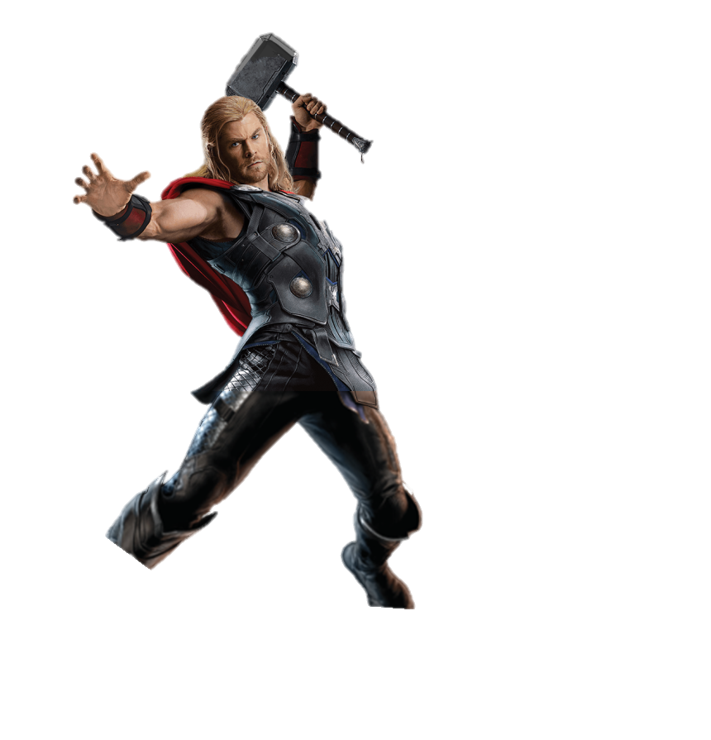

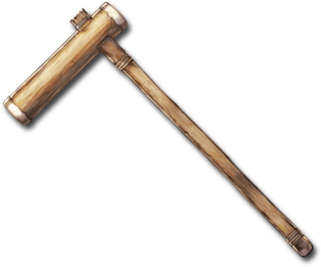

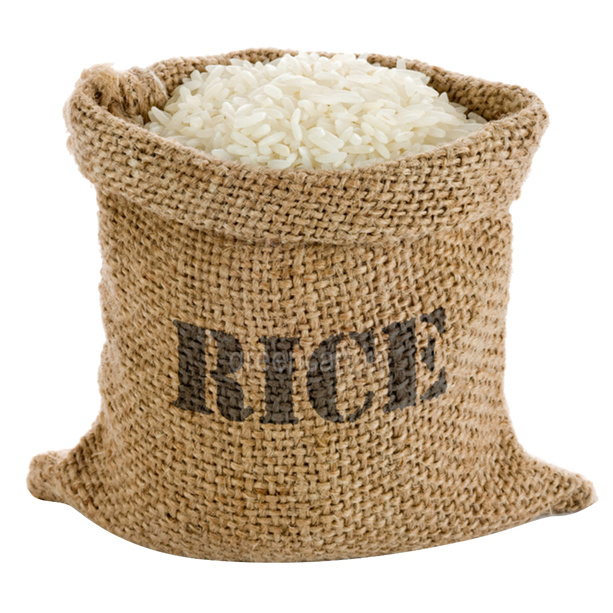


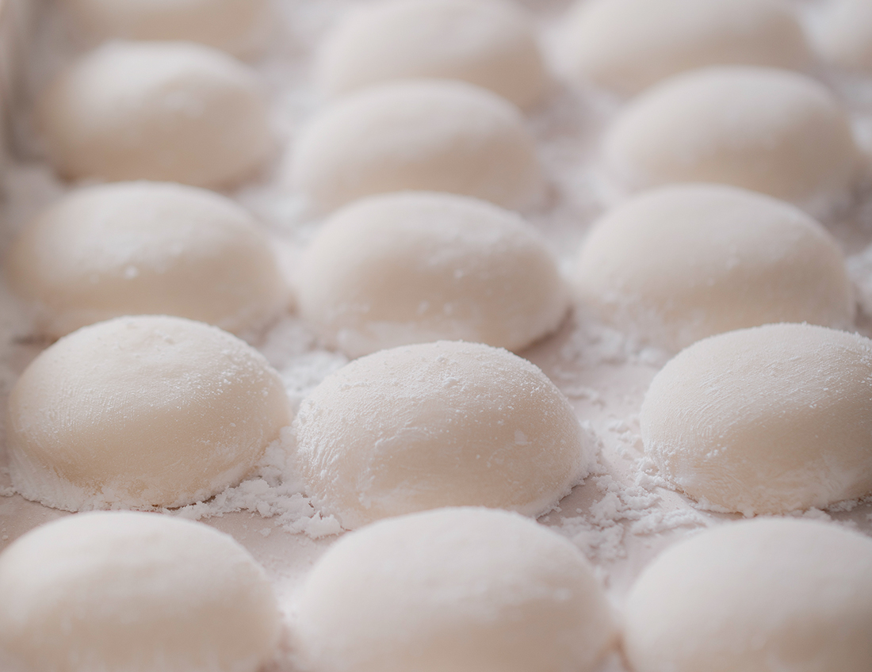
動詞：
makeの過去分詞
30 seconds
Hint
 |  |  | 前置詞
 |  |  | from
Mochi is made from rice.
6

Slide 9




動詞：
speakの過去分詞
Bonjour!
🇫🇷
English and French
Canada
Hello!
🇬🇧
30 seconds
English and French are spoken in Canada.
7

Slide 10
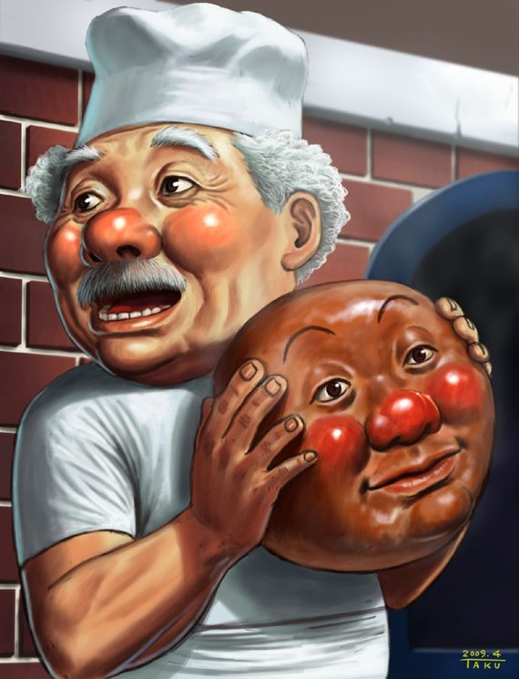
動詞：
makeの過去分詞
Jam Oji-san
30 seconds
Anpanman’s head
8
Anpanman’s head is made by Jam Oji-san.

Slide 11
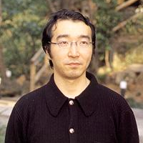
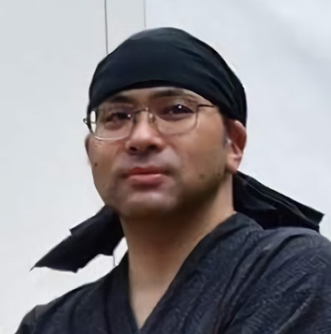

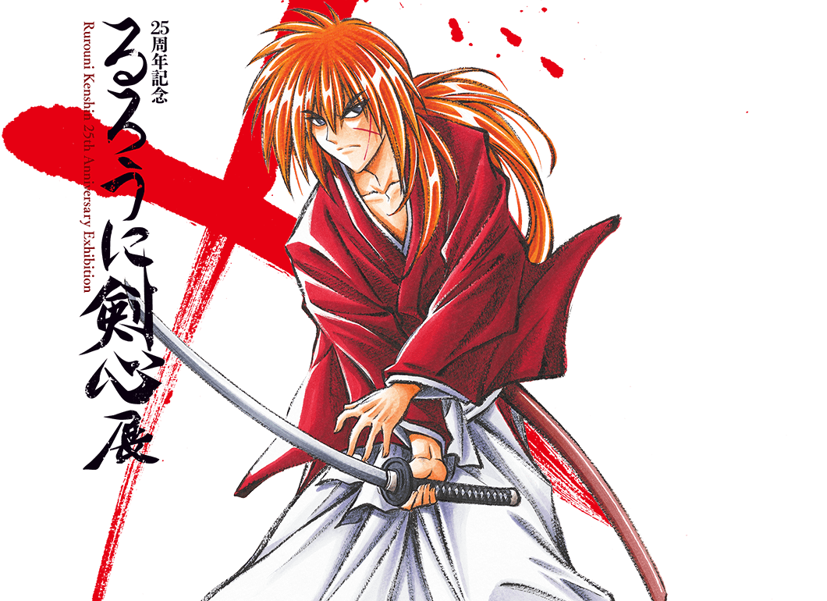
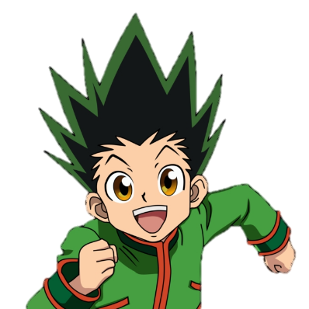
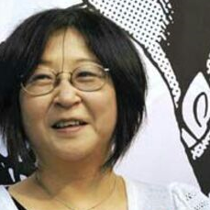
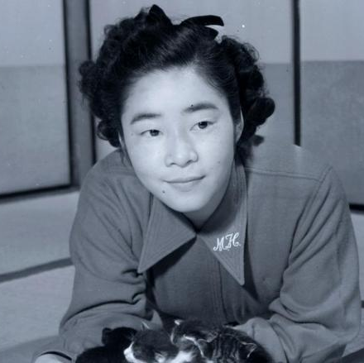

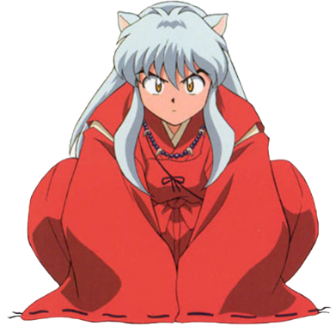
動詞：
writeの過去形
Rurouni Kenshin
Togashi Yoshihiro
Watsuki Nobuhiro
30 seconds
Takahashi Rumiko
Hasegawa Machiko
Rurouni Kenshin was written by Watsuki.
9

Slide 12

動詞：
singの過去分詞
if
30 seconds
If is sung by Nishino Kana.
10

Slide 13



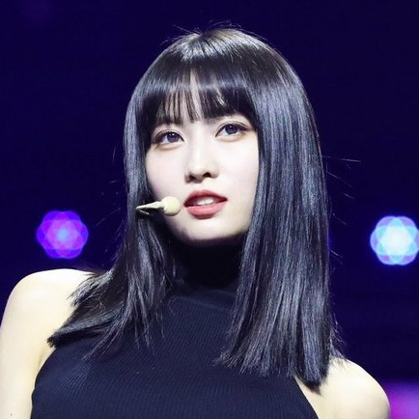
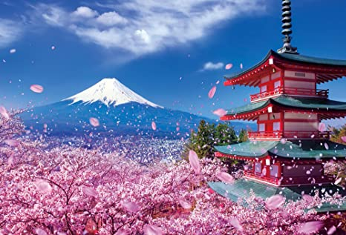
動詞：
bornの過去分詞
30 seconds
Tzuyu
Sana
Mina
Momo
~in Kyoto
Momo was born in Kyoto.
11

Slide 14





動詞：
winの過去分詞
30 seconds
12
Nippon Series was won by Chiba Lotte Marines in 2005

Slide 15
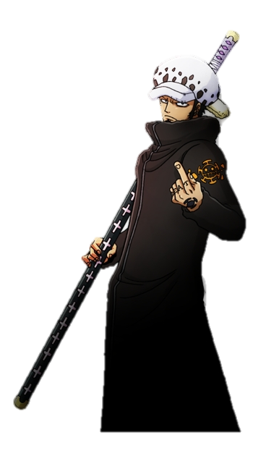
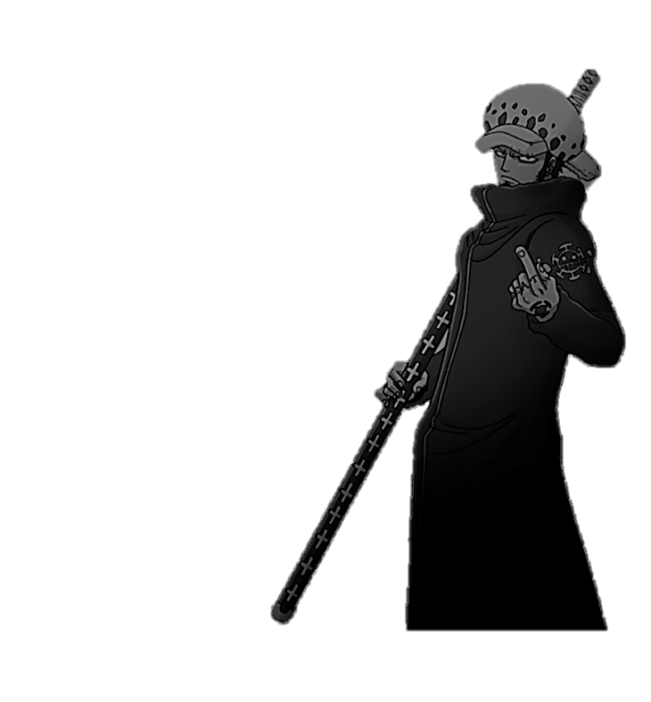
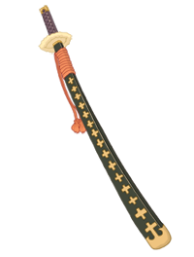
動詞：
useの過去分詞
30 seconds
?
This sword
13
This sword is used by Law.

Slide 16
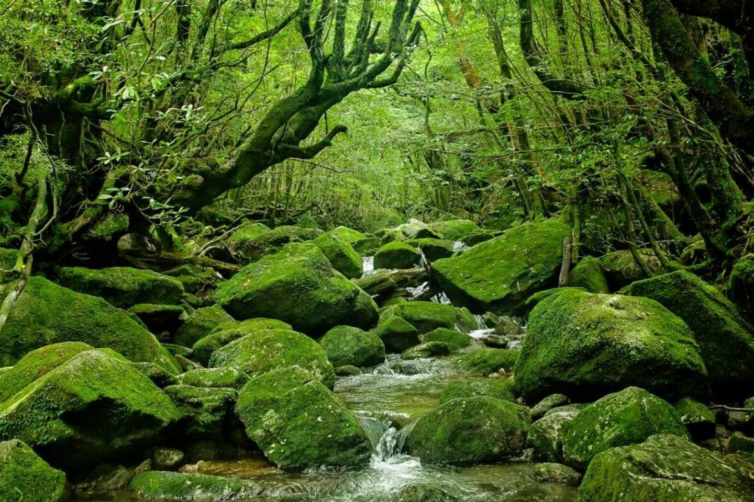
動詞：
takeの過去分詞
30 seconds
This picture
~in 場所
14
This picture was taken in Yakushima.

Slide 17
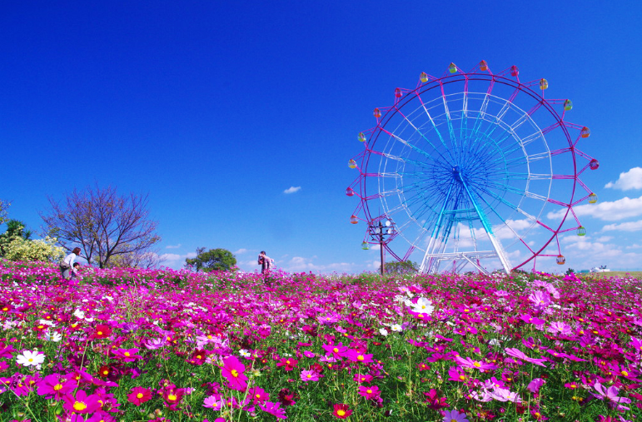
動詞：
takeの過去分詞
30 seconds
This picture
~in 場所
15
This picture was taken in Uminonakamichi.

Slide 18
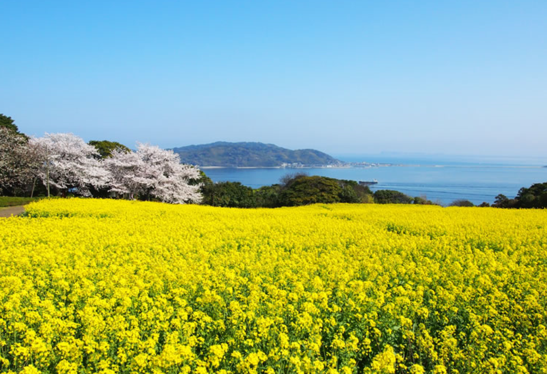
動詞：
takeの過去分詞
30 seconds
This picture
~in 場所
16
This picture was taken in Uminonakamichi.

