Slide 1
Second Year
Past Progressive Quiz
２年生 過去の進行クイズ

Slide 2
Rules: Teams
1 | 2 | 3 | 4

Slide 3
Rules: Rounds
1 | 2 | 3 | 4
Round 1 | Round 1 | Round 1 | Round 1
Round 2 | Round 2 | Round 2 | Round 2
Round 3 | Round 3 | Round 3 | Round 3
Round 4 | Round 4 | Round 4 | Round 4

Slide 4
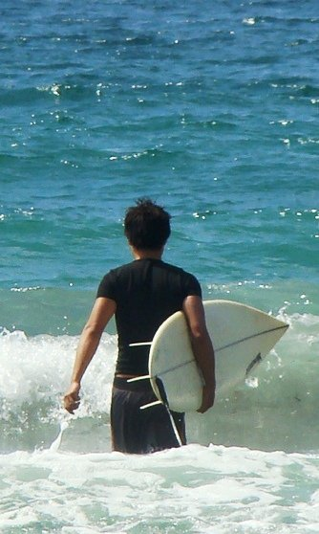
Look at the picture.
Look at when.
Write the sentence.
When:
last summer
You have 1 minute.
1 minute
Round 1 | Round 1 | Round 1 | Round 1
Subject 主語 | past be verb be動詞の過去形 | ~ing verb 動詞のing形 | when いつ
Matt
was
surfing
last summer

Slide 5
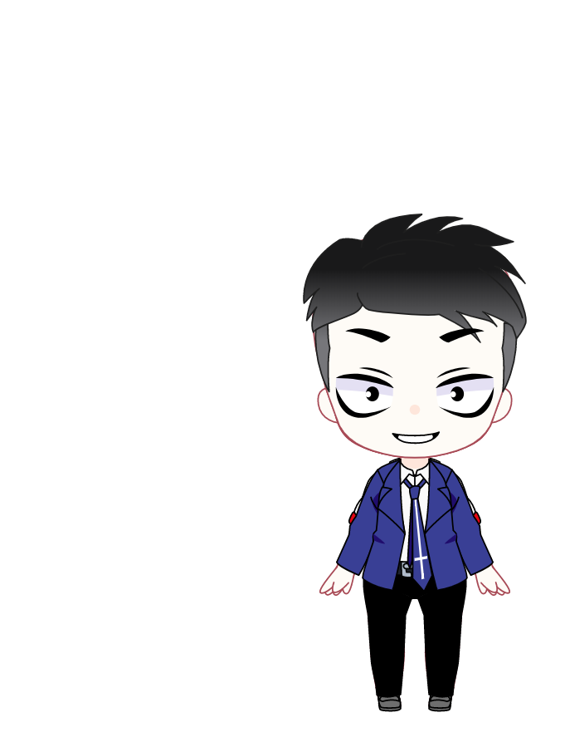


Rules: points
Rock
Paper
Scissors
One Two Three
Rock – Paper – Sissors
Perfect = 2 students play
Finished with some mistakes = 1 student play
Rock – Paper – Sissors
○＝ 3 points
△＝ 2 points
×＝ 1 point
5 | 2 | 3 | 4
○ | △ | △ | ○
2人 | 1人 | 1人 | 2人
2 | 3 | 2 | 3 | 3 | 1

Slide 6
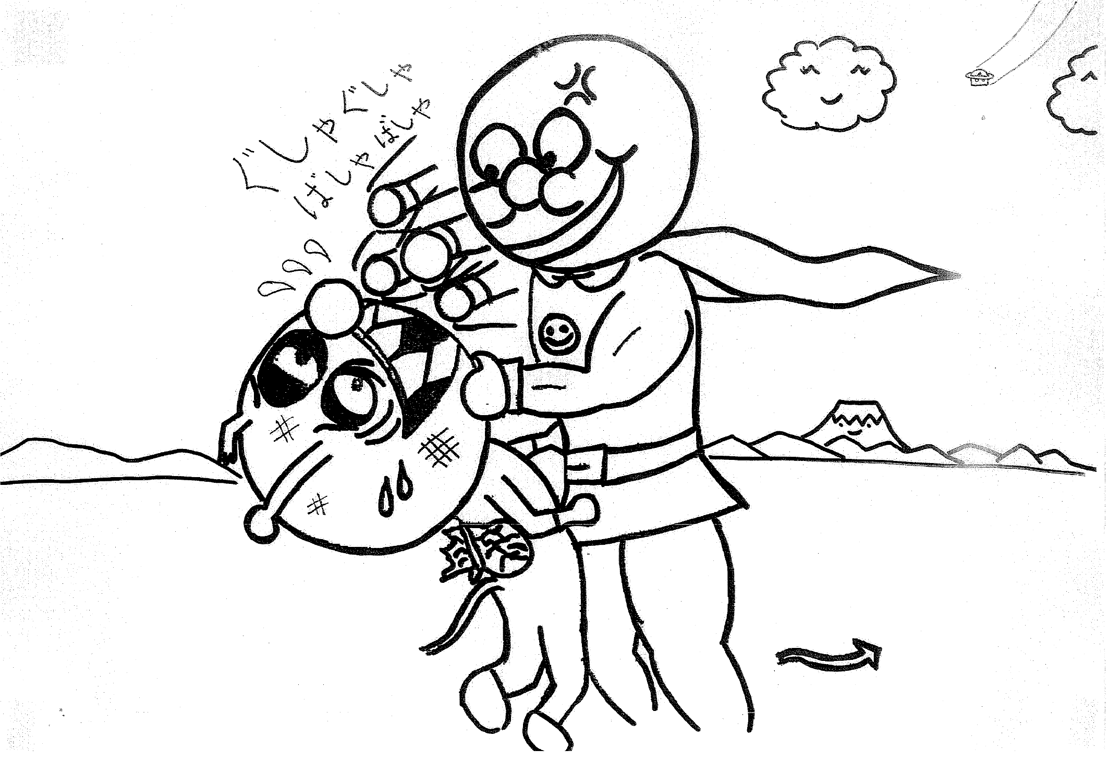
1
Time up!
When:
at 9:00
Word box:
Anpanman
Baikinman
punch
attack
fight
1 minute

Slide 7
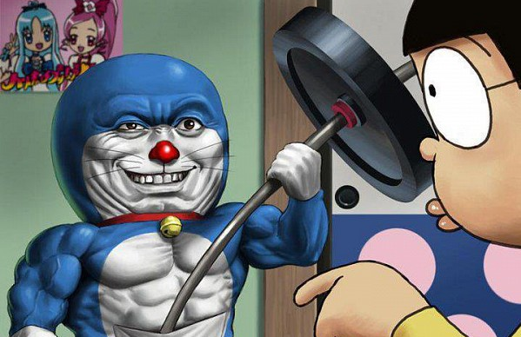
2
Time up!
When:
this morning
Word box:
Doraemon
dumbell
use
train
1 minute

Slide 8

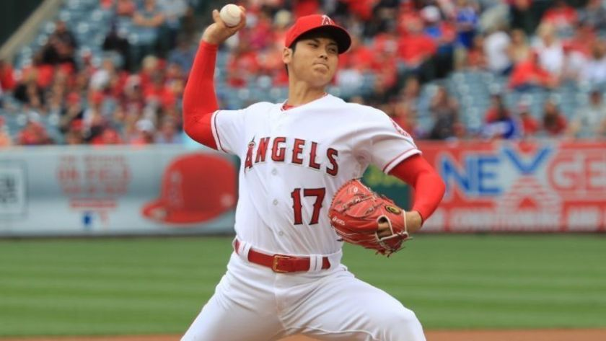
3
Time up!
When:
before the game
Word box:
Shohei
Pikachu
get
1 minute

Slide 9
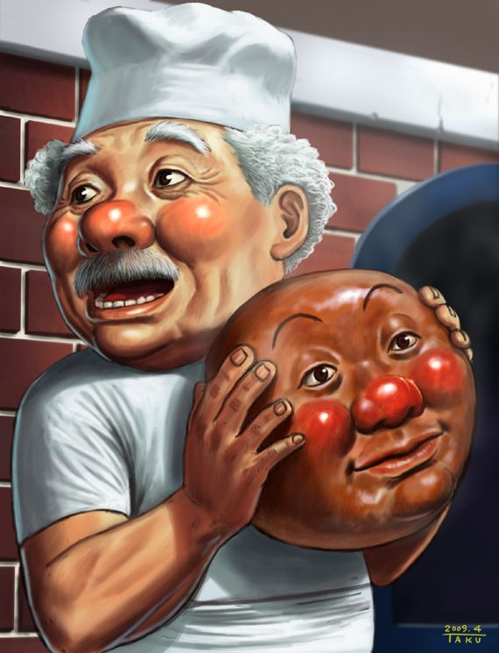
4
Time up!
When:
before breakfast
Word box:
Jam Ojisan
make
head
1 minute

Slide 10
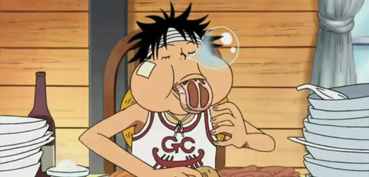
５
When:
after fighting

Slide 11
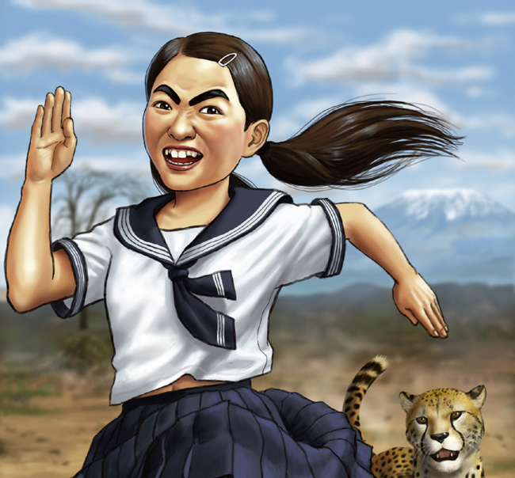
6
When:
on Sunday

Slide 12
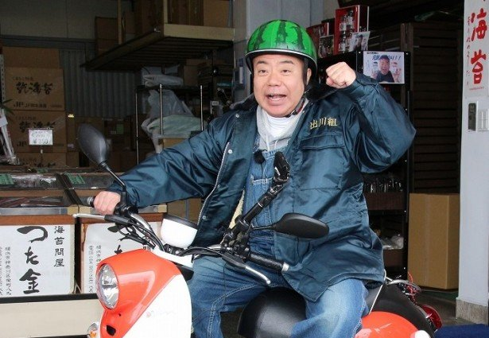
7
When:
on TV

Slide 13
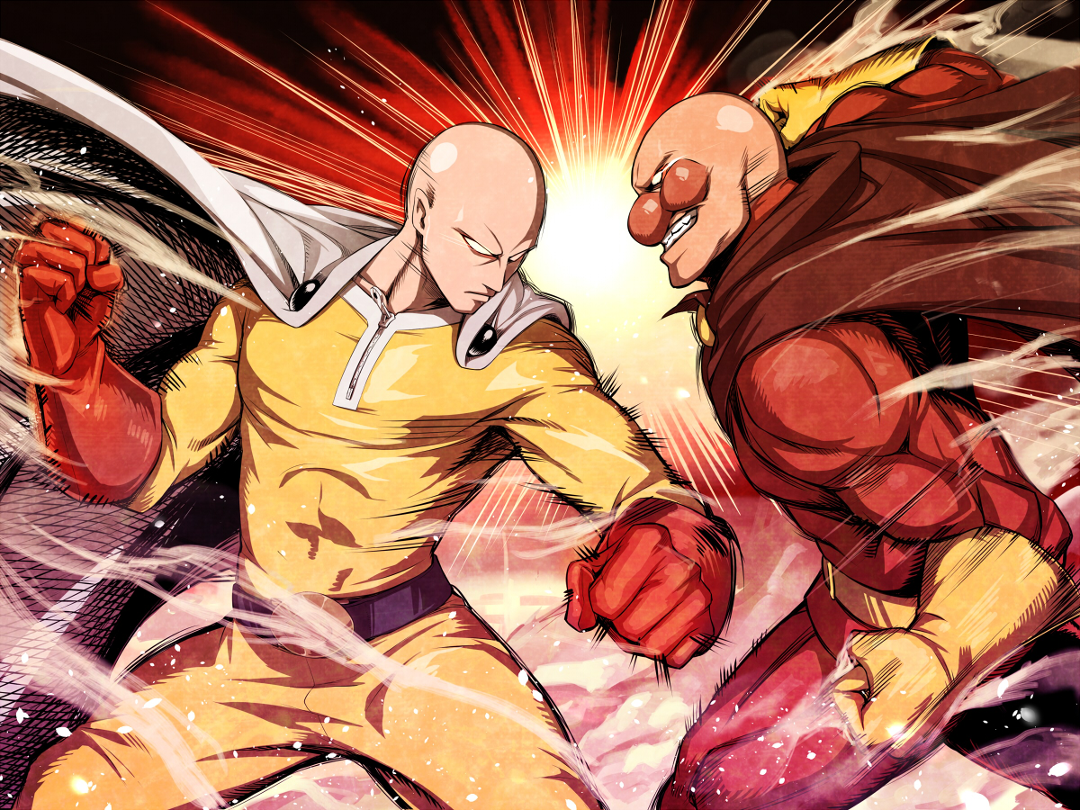
8
When:
last night

