Slide 1
Who is ○○?
Information Gap Game

Slide 2
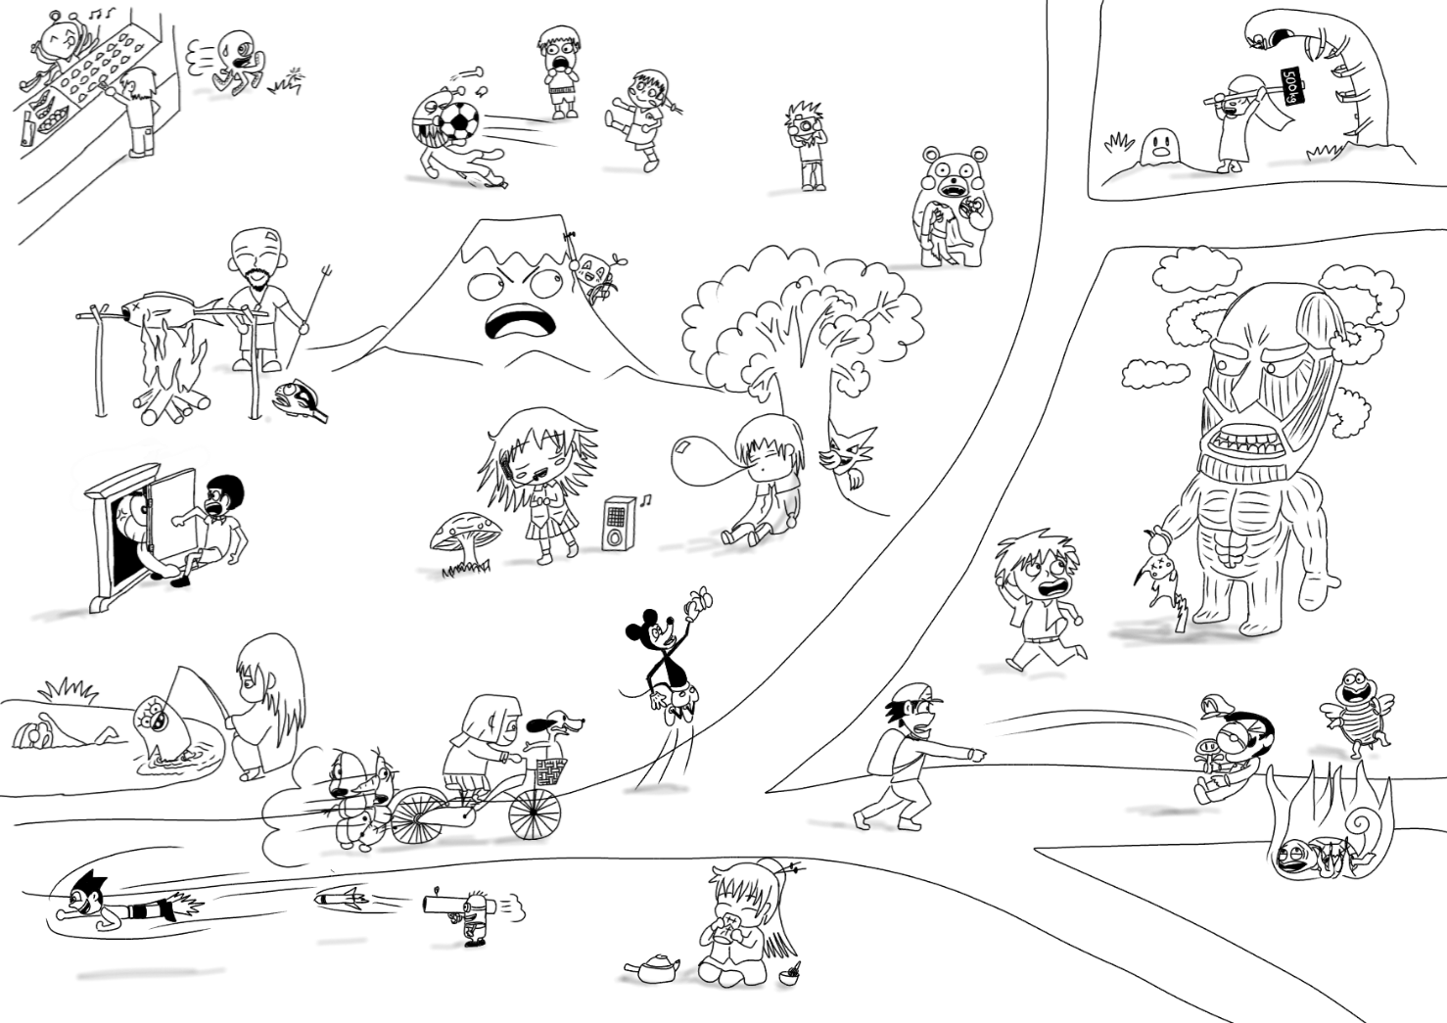
Each group gets this picture.

Slide 3

On your group’s picture, some characters will have names.
Group 1
These characters have names.

Slide 4
Different characters will have names in other groups.
Group 2
These characters have names.
Group 1
These characters have names.
Group 3
These characters have names.

Slide 5



To play: Step 1 you will get a mission card.
There is a
Mission Card Box
Take 1 Mission Card.
Mission Card

Slide 6
Step 1: Mission Cards
Read your card and check your group’s picture.
Mike
Group 2
Group 1
Who is Mike?
Group 2 has Mike on their picture.
Group 3
Group 2 can go to Step 3 and write the answer
Groups 1 and 3 don’t have Mike on their pictures. Groups that don’t have the answer must go to Step 2.

Slide 7
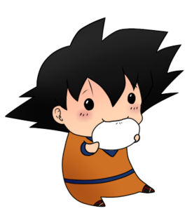



Step 2: Find Mike!
Group 2
If a group says, “No, we don’t,” then go to the next group.
One student goes to other groups to find Mike.
Do you know Mike?
Group 1
Do you know Mike?
No, we don’t.
When you find Mike, go back to your group.
Yes, we do.
Group 3
This is Mike.

Slide 8
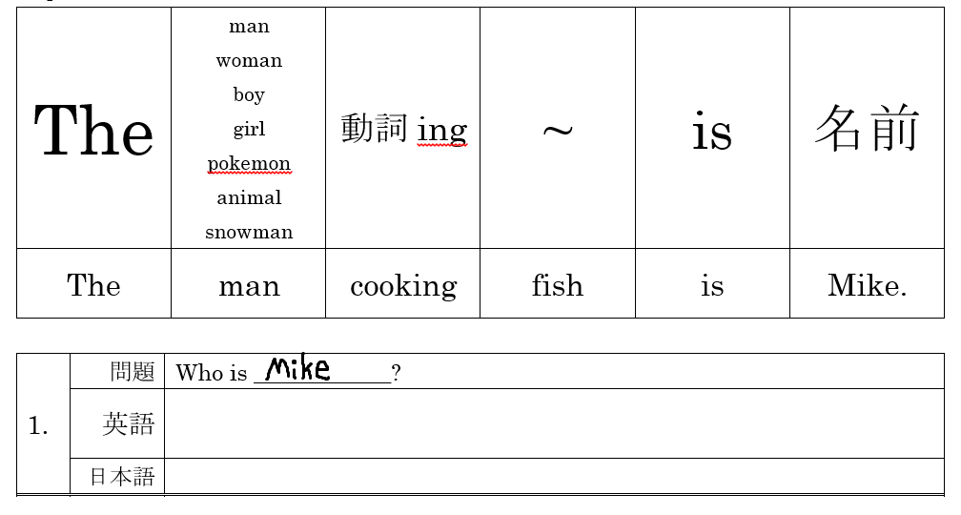
Step 3: Write the answer.
attacking
a girl
Mike.
The pokemon attacking a girl is Mike.
女の子を攻撃するポケモンはマイクです。

Slide 9


Check your answers.
Get another mission card
Roll dice for points
Mission Card

